Slide 1
Real Estate Trends
Max Gregory
Trevor Roberts Jr.
Rostand Bahanack Lonlack
Lee Simpson

Slide 2
Goal: Identify trends and answer questions regarding real estate sales in the United States to help potential buyers and sellers.

Slide 3
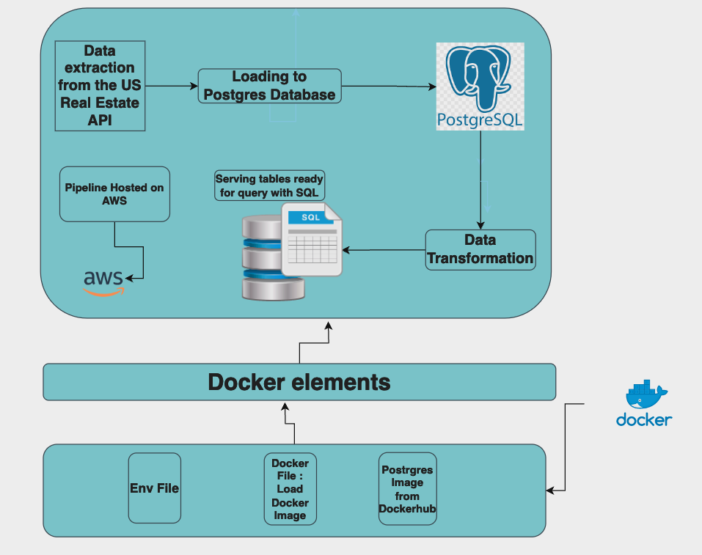

Slide 4
Questions
How long it took to sell the biggest homes per zip code?
Longest days on the market by home size?
Which cities, states, regions are seeing below/above national average home prices?
What is the average home price in a state and how do home prices compare in the zip code that a prospective buyer is searching for homes in?
How many sold homes are in each zip code?
When the most expensive homes were sold and where?

Slide 5
Methodology: ELT
Extract live data from an API
Load data to Postgres database
Transform data to find answers
Host project to cloud using AWS

Slide 6
Extract: Source
To find the correct API source, we determined questions to answer and worked backwards to find an API that offered relevant parameters
We used RapidAPI for US Real Estate with an endpoint focused on sold homes by zip code

Slide 7
Load: Postgres
Load API data to SQL Postgres database
Query data to find relevant information

Slide 8
Transform
Generate tables useful for end users to understand market trends
Filtering, cleansing, de-duplicating, validating and authenticating the data
Performing calculations, changing column headers for consistency, converting units of measurement and text strings, and by averaging values
Formatting the data into tables

Slide 9
AWS: Cloud Host
Leverage cloud global reach to serve our data to customers no matter where they are in the world.
Improved uptime by not relying on a single point of failure: the developer’s laptop.
Compute at cloud scale allows developers to allocate additional resources on-demand to improve workload performance.
An example of this is loading data to a database before performing transformations.

Slide 10
Challenges: Lessons Learned
Finding an API with the right parameters needed to answer questions took time
API limits/costs impacted the source we chose
Multiple requests to the API didn’t always work, had to find a workaround
AWS settings troubleshooting
Communication
Break down on Trello

